Slide 1
An Antenarrative Analysis of Donald Trump’s Dialectical Leadership in Society https://davidboje.wordpress.com for paper; slides at http://davidboje.com/quantum
David M. Boje, Ph.D.
Chair, NMSU Sustainability Council
Coordinator, Greening the Curriculum
Regents Professor

Slide 2
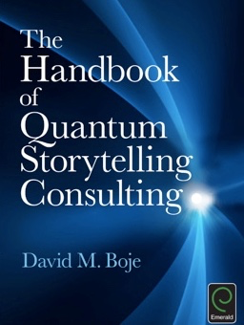

Slide 3
Quantum Storytelling
The words ‘quantum storytelling’ produce an image of antenarrative waves freewheeling in spacetimemattering, before they collapse into some particle of living story or a dominant narrative or counternarrative.

Slide 4
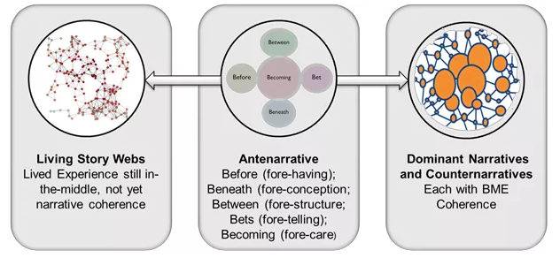
https://davidboje.wordpress.com

Slide 5
Definitions
SOS
Quantum → (noun) Smallest quantity of radiant energy that any system possesses to exist
Quanta → Plural of quantum; quanta are waves & particles; matter & non-matter; mass & non-mass; here & there at same time; measurable & non-measurable
Quantus → Latin for ‘how much?’
Quantum Storytelling → Things tell stories because Every Thing is QUANTA & alive, entangled energy waves

Slide 6
Antenarrative waves freewheeling in spacetimemattering, in advance
This image is very congruent with my sense of the existence of Antenarrative Generative Mechanisms (AGMs) as being antecedent, BEFORE-NARRATIVE, PRODUCING NARRATIVE in advance of spacetimemattering of leadership events and experiences such as TRUMP President-elect
Whole societies, with many cultures can be carried during AGM processes fore-caring for this or that future (antes are bets on the future).
I believe leadership in society to be part of such quantum antenarrative processes of fore-caring, in advance

Slide 7
Reaching our Quanta Limit
SOS
“Beyond a certain median per capita [QUANTA] energy level, the political system and cultural context of any society must decay”
→(Ivan Illich, Energy & Equity essay, bracket addition mine).

Slide 8
NMSU uses 3 million gallons of water each day
1 Million → Golf Course
1 Million → Lawn and Trees instead of desert landscaping
1 Million → Human Consumption
After 30 Million in budget cuts to faculty & staff, NMSU announced: Phase II NMSU Golf Course from 18 holes to 27-holes course → MORE WATER

Slide 9
Boje’s Sow and Reap Principle of fore-caring
When I met Grace Ann,
I did sow a thought…
Notes:
Sow a thought, Reap a word
Sow a word, Reap an action
Sow an action, Reap a habit
Sow a habit, Reap a character
Sow a character, Reap a destiny
“Watch your thoughts, they become words; watch your words, they become actions; watch your actions, they become habits; watch your habits, they become character; watch your character, for it becomes your destiny”
FRANK OUTLAW→Late President of the Bi-Lo Stores
→Often wrongly attributed to Ralph Waldo Emerson, its from news article by Frank Outlaw in May 1977, and popular again by Steven Covey (quote investigator)

Slide 10
Boje’s Principle of Design
"All organizations are perfectly designed to get the results they get.” → from Arthur Wayne Jones, as cited in David P. Hanna (1988: 38; 2001: 19)
Notes:
http://quoteinvestigator.com/2013/01/10/watch-your-thoughts/
Published on Jun 27, 2014
Often misattributed to W. Edward Deming in management, or Paul Batalden in Health policy (YouTube) What Deming did say: "Problems are the fault of the system 96% of the time and individuals 4% of the time." -- W. Edwards Deming
Paul Batalden, Medical Director, Senior Fellow, Institute for Healthcare Improvement (IHI), is Professor of Pediatrics, Community and Family Medicine and The Dartmouth Institute for Health Policy and Clinical Practice at Dartmouth Medical School. He teaches about the leadership of improvement of health care
Also see Hanna, David (2001). Leadership for the Ages: Delivering Today's Results, Building Tomorrow's Legacy David P. Hanna
Executive Excellence Pub., 2001 - Business & Economics
Arthur Wayne Jones says he had the insight 3- years ago -- http://ezinearticles.com/?All-Organizations-Are-Perfectly-Designed-to-Get-the-Results-They-Get&id=6560665

Slide 11
Rio Grande River has No Water End Sept until March

Slide 12
How Quantum Storytelling can help? It goes both ways
Antenarrative waves freewheeling Carnivalesque Theater for Social Change in spacetimemattering
Flash Mob breaks out
Protesting portrayals of VP-elect Pence
& to Help Fight Liberals
Shouting USA, USA, USA…

Slide 13
FACTS
SOS
Average USA person’s carbon footprint
20 tons carbon dioxide per year compared
1.1 tons for average person in India
5% of world’s population in the USA create
20% of carbon dioxide emissions &
30% of the world’s resources consumed.
Notes:
GREENHOUSE GASSES (GHGs: Carbon Dioxide, Methane, Nitrous Oxide): Average USA person generates > 10 times the GHG as the average Chinese
GLOBAL CARBON EMISSION: Average USA person generates 10 tons per person per year, but average person elsewhere produces only 1 ton per person per year

Slide 14
PROBLEM: Science is not persuading Climate Deniers to Believe Climate Science
Koch Brothers EXPOSED: 2014 (ft. Bernie Sanders) • FULL DOCUMENTARY FILM • BRAVE NEW FILMS – did not work
Follow the money and what is happening to defunding of K-12 and Higher Education. – did not work

Slide 15
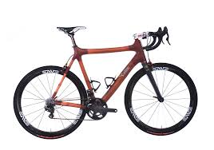
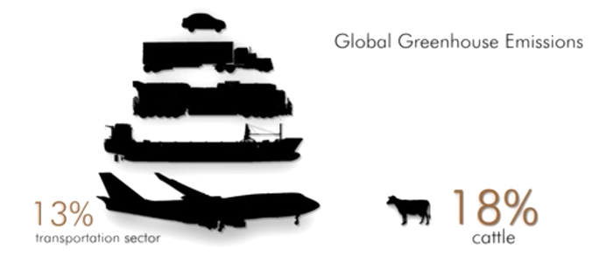
Which produces more CO2? TRANSPORTATION or COWS
SOS

Slide 16
YOUR RESISTENCE IS FUTILE IN SOCIETY OF SPECTACLE
IN TRUMP-LAND THESE ARE ‘REAL’ TRUTHS:
1. Who needs clean air?
2. CO2 is liberal propaganda? Automobility is necessity!
3. Who needs clean water? Buy Coke or Pepsi
4. Vegans are idiots? You need Carl’s Jr. ‘real’ meat to think.
5. Forget the poor, reward the rich!

Slide 17
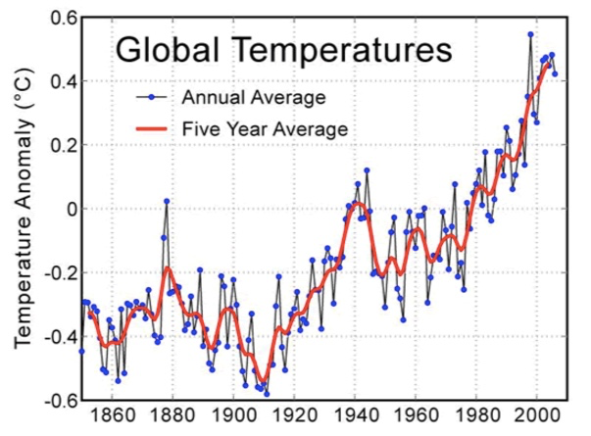

Slide 18
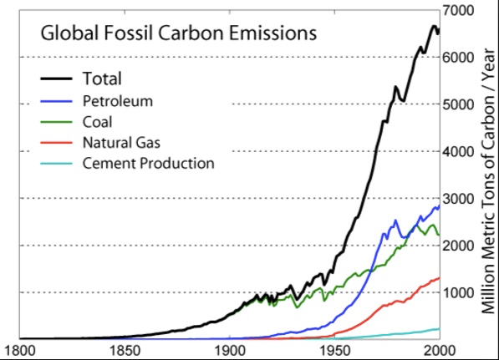

Slide 19
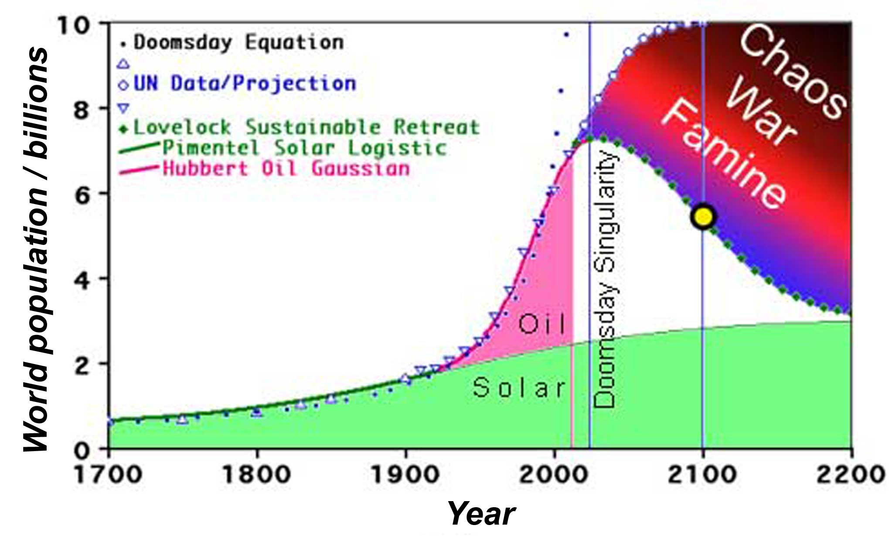
DOOM: POPULATION 11 BILLION
In year 2100
Temperature Trend
REVENGE of GAIA
Notes:
Adapted from http://electromontis.net/evoligion/_E/E20.shtml
In Lovelock's 2006 book, The Revenge of Gaia, he argues that the lack of respect humans have had for Gaia, through the damage done to rainforests and the reduction in planetary biodiversity, is testing Gaia's capacity to minimize the effects of the addition of greenhouse gases in the atmosphere. This eliminates the planet's negative feedbacks and increases the likelihood of homeostatic positive feedback potential associated with runaway global warming.

Slide 20
Who consumes more WATER & FOOD? HUMANS or COWS
SOS
Notes:
Albert Einstein said “Nothing will benefit health and increase the chance for survival of life on Earth as the evolution to a vegetarian diet” –Albert Einstein

Slide 21
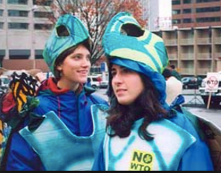
Carnivalesque is Back!
I am writing with Michael Brenner and Rick Herder (rhetoric) about how to use our interest in Theater for Social Change in Trump-land?

Slide 22
Carnivalesque Research Question
What does antenarrative agency look like in Trump-land Society of the Spectacle of Derealization, and Hyperrealization makes everything Liberal ‘Unspeakable’? Voice of the Voiceless
Walter Benjamin returns, looking back on the wreckage of history, blowing the Angel away, but keeps piling ruin upon ruin and hurls it in front of Angel’s feet, and the Angel can no longer close his wings --- Ninth Thesis on the Philosophy of History

Slide 23
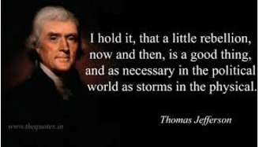
Thomas Jefferson was right!

Slide 24
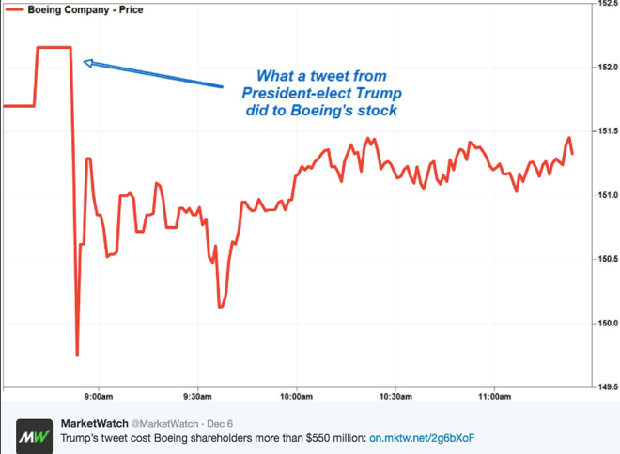
We live in Society of Spectacle with consequents

Slide 25
Spectacle Society: Trum Tweet effects → Stock price
Tweet cost Boeing shareholders more than $550 million” (Market Watch, Dec. 6, Twitter.com).
“Boeing Gives Trump Phone Call Within Hours of Trump’s Tweet Vowing To Work With Him To Reduce Costs on Air Force One” (Dec. 7, IBID.).
We need leadership science to make sense of the domain of actual Trump events and experiences. “An experiences are often (epistemically speaking) ‘out of phase’ with events — e.g. when they are misidentified” (Bhaskar, 1975: 13).
Leadership science needs some ontological training or education because the domains of the real, actual, and empirical are distinct.

Slide 26
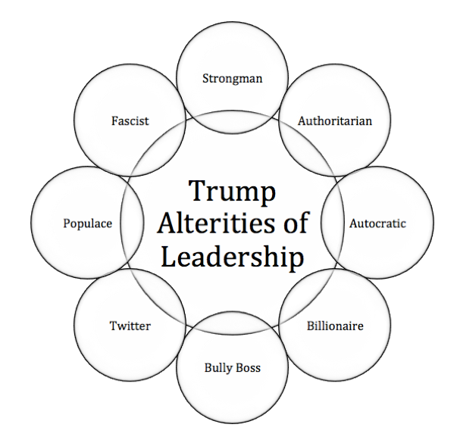

Slide 27
FAST FOOD and CLIMATE DENIERS in Trump Leadership Picks
Carl’s Jr. Andy Puzder, the fast-food CEO chosen for Labor secretary, raised campaign cash for Trump and personally contributed $388,000 to the RNC and $150,000 to Trump’s joint fundraiser. He also gave $10,000 to Rebuilding America Now.
ExxonMobil CEO Rex Tillerson chosen for Secretary of State.
Myron Ebell picked to lead his EPA transition team. Ebell is Director of the Center for Energy and Environment at the industry-funded Competitive Enterprise Institute (CEI).
Scott Pruitt to head up EPA, Oklahoma attorney general, who is a close ally of the fossil fuel industry.

Slide 28
Carnivalesque is Back!
Trump Leadership is SPACETIMEMATTERING of the SOCIETY OF THE SPECTACLE (Guy Debord)
Therefore, we need Theater of the Oppressed (Augusto Boal)
US & New Mexico Government have become RIDICULOUS SPECTACLE
Therefore, we need Prankster Carnivalesque HUMOR

Slide 29
Carnivalesque
We need healthy fun with lots of IRONY dialectical to the SPECTACLE ENTERTAINMENT diversion of Humorless Statecraft
WHY? Direct confrontation of counternarratives to Trump-land narratives will be CRUSHED, is no solution
Therefore, need little windows of opportunities for Carnivalesque subversion, creative disrespect, masks, and role reversals (e.g. the poor become masters using brooms [symbolically] sweeping away the wealthy corrupt class

Slide 30
VETERANS THEATER is Theater of the Oppressed
Act 1 – Viva Las Vegas – is role reversal of how the homeless mentally ill look at the Wheel of Fortune in New Mexico
Act 2 – Spice Head Falls Out – is role reversal as Professor John W. Huffman gets attacked by Spice-Zombies for inventing 450 kinds of synthetic marijuana, as he claims protection of IRB
Act 3 – 999 Amador – is Forum Theater – where audience spectators become actors (spect-actors) to deal with Bully Boss use of Homeless Labels

Slide 31
Carnivalesque IDEAS
Trump, ExxonMobil, Koch Brothers, Carl’s Jr. and every Billionaire Scrooge resign yourselves to the Saturday Night Live skits. NEW SKIT IDEAS:
1. Homeless March with brooms (symbolically) sweeping the rich off the street, because Rich grew fat at expense of the poor and middle class
2. A Golf Tournament – where poor in masks of Trump play through
3. Jose Bove agribusiness protest of Carl’s Jr.

Slide 32
How to Carnivalize CLIMATE DENIAL?
Climate Denial debates Climate Science, and thanks to ExxonMobil and Koch Brothers funding has turned climate science into debate.
What kind of Carnivalesque opportunities for Theater of Oppressed can you envision?

Slide 33
How to Carnivalize New Mexico Defunding of K-12 & Higher Education?
It’s a situation in NM where anti-gas and oil industry that now funds K-12 & H.E. are stifled
Gas and Oil severance taxes instead of ‘Real’ taxes pay-down K-12 and H.E., but Domenici buildings, 3 million gallon water use daily, and 27 hole golf courses are built everyday at NMSU.
QUESTION: what are Carnivalesque and Theater of Oppressed and Broom Marches your creative humor can come up with?

Slide 34
SOS = REASON + UNDERSTANDING
Notes:
At the center of the SOS figure is a green ‘Heart of Care’, which I presented along with joni newcomer and several management and marketing doctoral students (of Mgt 655 systems theory doctoral seminar) to our former university President Barbara Couture, former Provost Wendy Wilkins, and still our VP of Research, Vimal Chaitanya, May 2011. Aguirre, G; Boje, D.; Cast, M.; Conner, S. Helmuth, C.; Mittal, R.; Saylors, R.; Tourani, N.; Vendette, S.; Yan, T. Q. (2013). “University Sustainability and System Ontology,” Special Issue: Organizational Innovations and Responses for Universal Equilibrium, International Journal of Organization Theory and Behavior, Vol. 15(4): 577-618. Co-authors are from Management and Marketing departments of New Mexico State University who did research interviews with the sustainability leaders on main campus, and are listed in alphabetical order. Click here for pre press pdf.

Slide 35
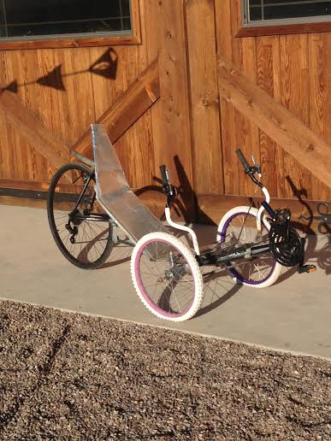
Fore-caring? Would you Bike to Work? Boje’s Recumbent Trike

Slide 36
MY SOW AND REAP POINT
ANTE1: Most people are not going to Bike to work o
ANTE2: Become Vegan
ANTE3: Less Golf = More Water
CONSEQUENTS: C02 will continue to rise, Less Water of Life because No Fore-Caring for Future Generations, in advance

Slide 37
CARBON FOOTPRINT of USA
SOS
Total greenhouse gases produced by human activities =
tons of carbon dioxide (CO2).
Natural CO2 cycle→CO2 gets re-absorbed by plants and trees

Slide 38
NMSU HISTORY OF SUSTAINABLITY
SOS
WWRI Water Resources Research Institute
SWTDI Southwest Technology Development Institute
LTER Long Term Ecological Research · Jornada Basin
WERC Waste-management Education and Research Consortium; new name is: A Consortium for Environmental Education and Technology Development
For entire history → greening.nmsu.edu
Notes:
School of Sustainability is 3rd year initiative of the GREENING THE CURRICULUM program funded by President’s Excellence Initiative in 2014
SOS (School of Sustainability) is in partnership with Sustainability Council
WWRI Water Resources Research Institute
SWTDI Southwest Technology Development Institute
LTER Long Term Ecological Research · Jornada Basin
WERC Waste-management Education and Research Consortium
WERC new name is: A Consortium for Environmental Education and Technology Development

Slide 39
University Negations of People & Answerability to Ecosystem
NMSU is an entity is going through cost-cutting ($12.3 million already) and more to come. Each cutting is an absenting (120 positions of faculty, staff, mid-level administrators) – have already been cut:
July 14 2016”belt-tightening continues: NMSU said … it will cut more than 120 faculty and staff positions and trim budgets across academic and administrative units to save more than $12 million this fiscal year” source
“NMSU will eliminate 89 vacant positions, including 27 faculty and 62 staff. The system will cut 37 currently staffed positions, including three faculty and 34 staff. Human resources will review whether staffers whose jobs are cut may be transferred into other vacancies” source
Entire departments & units are being merged, or dissolved ($828,000 cut by dissolving Health Services),
“The cuts all apply to the university’s $178 million “instruction and general,” or I&G budget – the portion of the $622 million total system budget that is covered by tuition and appropriations” source
Before changes enrollment has fallen to about 15,490 in 2015. Will the transformations make it fall further?
How NMSU budget-cutting math logic co-exists with EXPANDING GOLF

Slide 40
SOS 11 BILLION

Slide 41
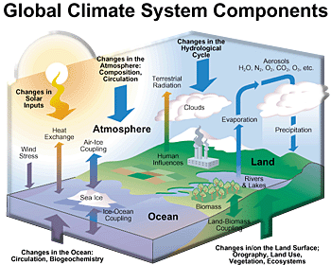

Slide 42
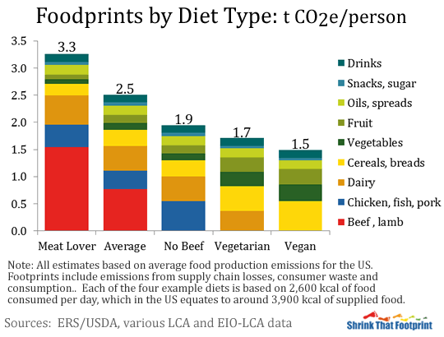
Would you CHANGE your FOOD-PRINT?

Slide 43
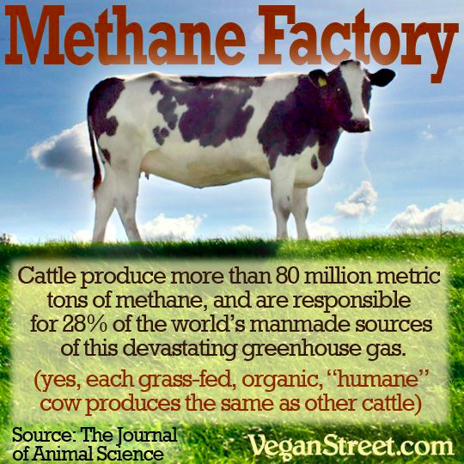

Slide 44
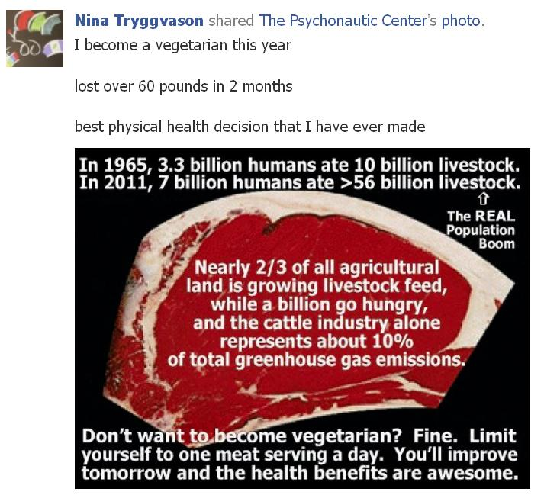

Slide 45
How to have less of a FOOTPRINT on Earth?
1. Walk and Bike more
2. Change your Diet a little
3. Scale down Energy Use
4. Less Golf, More Water
5. Be SOS – School of Sustainability @ NMSU

Slide 46
THANK YOU
SOS
https://davidboje.wordpress.com Antenarrative Blog for paper;
slides at http://davidboje.com/quantum
Send your presentations to davidboje@gmail.com to get them into the 2016 Proceedings of Quantum Storytelling Conference
http://davidboje.com/quantum has our Proceeding Papers/Slides for the conference.

